Slide 1
Forecasting Tomorrow’s Electricity Demand in New South Wales
ZZSC9020 DATA SCIENCE CAPSTONE
GROUP A
Kelly Hamilton · Daniel Cao · Swapnil Shinde · Faiza Mumtaz · Xavier Sun · Arman Hajisafi
October 2026

Slide 2
1. Team Intro
by Swapnil

Slide 3







THE TEAM
Arman
Data Engineer
Daniel
MLE Lead
Faiza
Data Scientist
Group A is made up of
6 team members.
A combination of
knowledge and skills
in various fields can
enhance business performance.
Kelly
Research Lead
Swapnil
Team Lead
Xavier
Product Manager

Slide 4
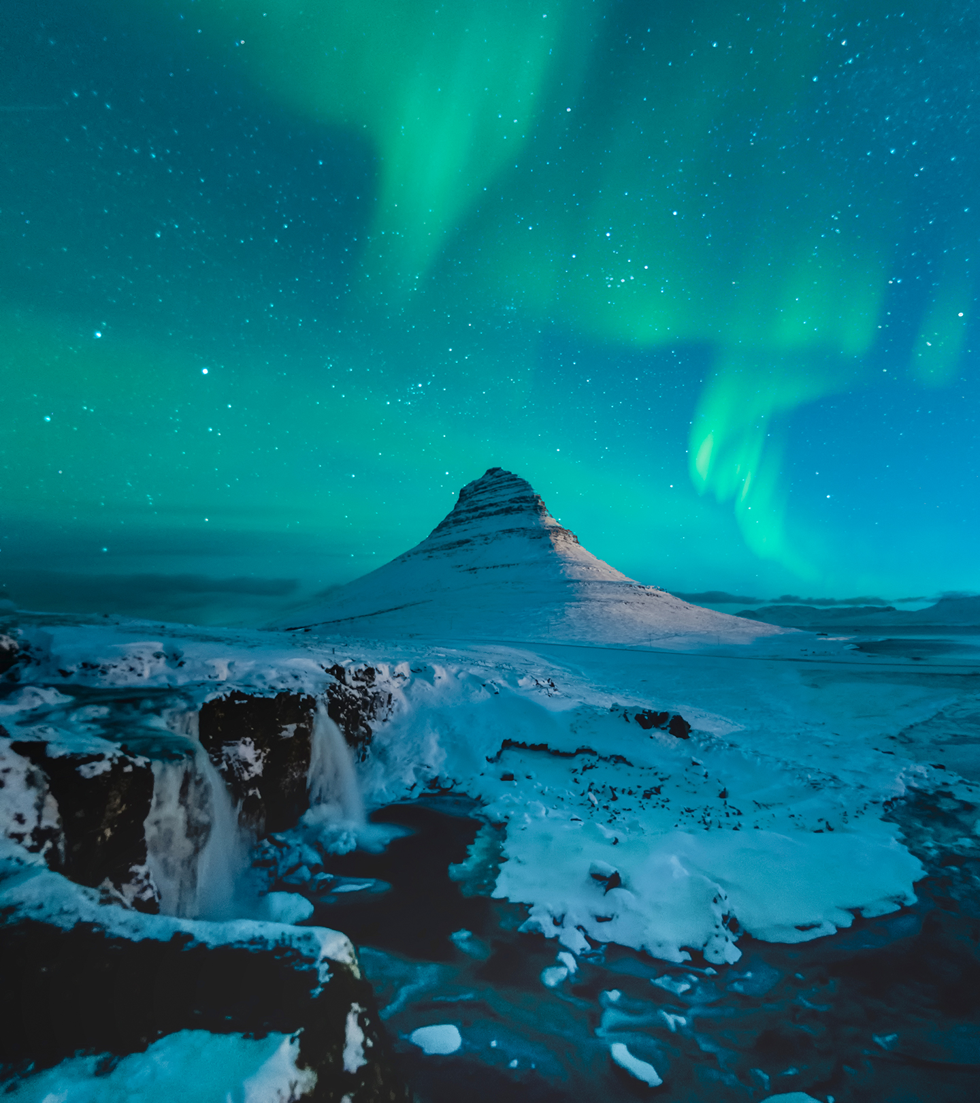
Agenda
Introduction Swapnil
Problem Statement Kelly
Our Process Daniel
Findings Faiza
Results Xavier
Proposal Arman
Notes:
Intro: 2min
Problem Statement: 3min
Process: 2.5min
Findings: 2.5min
Result: 2.5min
Proposal: 2.5min

Slide 5
2. Problem Statement
by Kelly

Slide 6
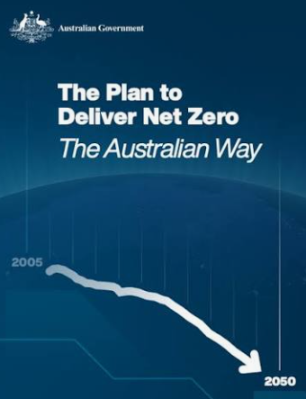


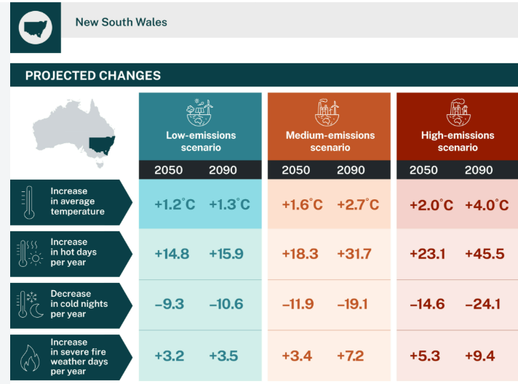
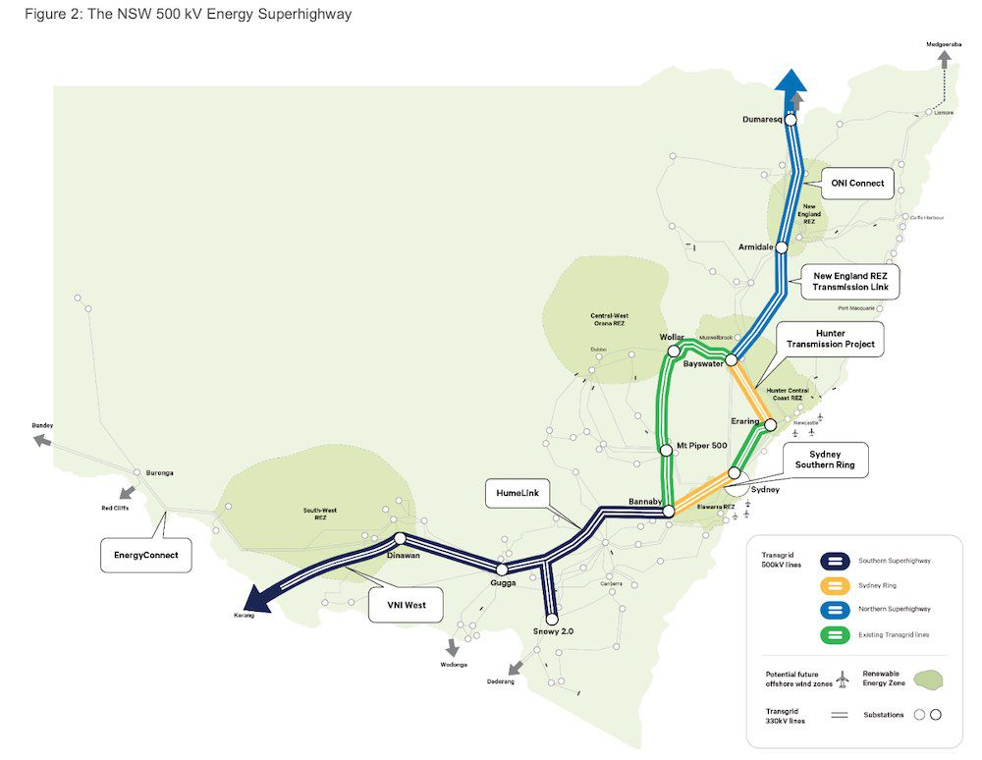
Why Tomorrow’s Demand Matters Today
SDG à Net Zero 2050 à Reduction by 2030 à ISP 2026 à Project Energy Connect à Nov 2026
Energy grid demands
BY 2028: Monitor: Solar; Wind and Battery conditions to determine Tomorrow’s Green energy supply to grid
Before we can optimise allocation of tomorrow's electricity... how accurately can we predict how much NSW will need… and which model remains reliable over long term temperature and seasonal change?

Slide 7
Creating the Brain
Aim: Create a brain to forecast demand under local fluctuating conditions.
Research Question: Which forecasting models perform best for short-term electricity demand in New South Wales when evaluated across seasonal variation and temperature changes?
Review of prior studies revealed:
  Computational overhead --> Complex models cost time and money
  Accuracy matters --> Inaccurate models cost time, money, and potential consumer trust
  Data granularity matters --> the better data collected and fed, the more accurate the model; the more money and energy saved later.

Slide 8
Creating the Brain
Aim: Create a brain to forecast demand under local fluctuating conditions.
Research Question: Which forecasting models perform best for short-term electricity demand in New South Wales when evaluated across seasonal variation and temperature changes?
Review of prior studies revealed:
  Computational overhead --> Complex models cost time and money
  Accuracy matters --> Inaccurate models cost time, money, and potential consumer trust
  Data granularity matters --> the better data collected and fed, the more accurate the model; the more money and energy saved later.

Slide 9
Creating the Brain
Aim: Create a brain to forecast demand under local fluctuating conditions.
Research Question: Which forecasting models perform best for short-term electricity demand in New South Wales when evaluated across seasonal variation and temperature changes?
Review of prior studies revealed:
  Computational overhead --> Complex models cost time and money
  Accuracy matters --> Inaccurate models cost time, money, and potential consumer trust
  Data granularity matters --> the better data collected and fed, the more accurate the model; the more money and energy saved later.

Slide 10
3. Our Process
by Daniel

Slide 11
From messy files to one cleaned table
To help determine the best forecasting model, we combined 11 years of demand, weather and calendar data into one centralised source for every model to learn from
Provided to us
Demand¹: NSW electricity use, every half hour
Checked and cleaned the data
Lined everything up by time
Combined it into one table⁶
Temperature²: Readings from Bankstown airport
AEMO’s forecasts³: the market operator’s own predictions
One cleaned table⁷:
One row for every half hour across 2010 to 2021, almost 200,000 rows
Added by us
Sunshine⁴: Daily solar radiation in Bankstown
Calendar⁵: Public holidays, day of week, school terms, etc
Sources:
1. https://github.com/danielc088/ZZSC9020-group-A/blob/main/data/NSW/totaldemand_nsw.csv.zip
2. https://github.com/danielc088/ZZSC9020-group-A/blob/main/data/NSW/temperature_nsw.csv.zip
3. https://github.com/danielc088/ZZSC9020-group-A/tree/main/data/NSW
4. https://github.com/danielc088/ZZSC9020-group-A/blob/main/data/NSW/solar_radiation_bankstown_66137.csv
5. https://github.com/danielc088/ZZSC9020-group-A/blob/main/src/data_joined.ipynb
6. https://github.com/danielc088/ZZSC9020-group-A/blob/main/src/data_cleaning.ipynb
7. https://github.com/danielc088/ZZSC9020-group-A/blob/main/data/NSW/nsw_cleaned.csv
Notes:
Before we get to which model performed best, I want to quickly walk through what we started with, and how we got it ready.
To help determine the best forecasting model, we first needed all of our data in one place. We were provided with three datasets. The first was New South Wales electricity demand, recorded every half hour. The second was temperature readings from Bankstown Airport. And the third was AEMO's own forecasts, which is what the market operator already predicts demand to be.

Slide 12
From messy files to one cleaned table
To help determine the best forecasting model, we combined 11 years of demand, weather and calendar data into one centralised source for every model to learn from
Provided to us
Demand¹: NSW electricity use, every half hour
Checked and cleaned the data
Lined everything up by time
Combined it into one table⁶
Temperature²: Readings from Bankstown airport
AEMO’s forecasts³: the market operator’s own predictions
One cleaned table⁷:
One row for every half hour across 2010 to 2021, almost 200,000 rows
Added by us
Sunshine⁴: Daily solar radiation in Bankstown
Calendar⁵: Public holidays, day of week, school terms, etc
Sources:
1. https://github.com/danielc088/ZZSC9020-group-A/blob/main/data/NSW/totaldemand_nsw.csv.zip
2. https://github.com/danielc088/ZZSC9020-group-A/blob/main/data/NSW/temperature_nsw.csv.zip
3. https://github.com/danielc088/ZZSC9020-group-A/tree/main/data/NSW
4. https://github.com/danielc088/ZZSC9020-group-A/blob/main/data/NSW/solar_radiation_bankstown_66137.csv
5. https://github.com/danielc088/ZZSC9020-group-A/blob/main/src/data_joined.ipynb
6. https://github.com/danielc088/ZZSC9020-group-A/blob/main/src/data_cleaning.ipynb
7. https://github.com/danielc088/ZZSC9020-group-A/blob/main/data/NSW/nsw_cleaned.csv
Notes:
]On top of that, we added two of our own. The first was sunshine, which is the daily solar radiation in Bankstown. The second was calendar information, so things like public holidays, the day of the week and school terms. We added these because demand looks quite different when businesses and schools are closed.

Slide 13
From messy files to one cleaned table
To help determine the best forecasting model, we combined 11 years of demand, weather and calendar data into one centralised source for every model to learn from
Provided to us
Demand¹: NSW electricity use, every half hour
Checked and cleaned the data
Lined everything up by time
Combined it into one table⁶
Temperature²: Readings from Bankstown airport
AEMO’s forecasts³: the market operator’s own predictions
One cleaned table⁷:
One row for every half hour across 2010 to 2021, almost 200,000 rows
Added by us
Sunshine⁴: Daily solar radiation in Bankstown
Calendar⁵: Public holidays, day of week, school terms, etc
Sources:
1. https://github.com/danielc088/ZZSC9020-group-A/blob/main/data/NSW/totaldemand_nsw.csv.zip
2. https://github.com/danielc088/ZZSC9020-group-A/blob/main/data/NSW/temperature_nsw.csv.zip
3. https://github.com/danielc088/ZZSC9020-group-A/tree/main/data/NSW
4. https://github.com/danielc088/ZZSC9020-group-A/blob/main/data/NSW/solar_radiation_bankstown_66137.csv
5. https://github.com/danielc088/ZZSC9020-group-A/blob/main/src/data_joined.ipynb
6. https://github.com/danielc088/ZZSC9020-group-A/blob/main/src/data_cleaning.ipynb
7. https://github.com/danielc088/ZZSC9020-group-A/blob/main/data/NSW/nsw_cleaned.csv
Notes:
We then did three things. We checked and cleaned the data, we lined everything up by time, and we combined it into one table. The data itself was actually quite clean. The main challenge was that the files didn't line up with each other, so most of the work was getting everything onto the same half-hourly timeline.

Slide 14
From messy files to one cleaned table
To help determine the best forecasting model, we combined 11 years of demand, weather and calendar data into one centralised source for every model to learn from
Provided to us
Demand¹: NSW electricity use, every half hour
Checked and cleaned the data
Lined everything up by time
Combined it into one table⁶
Temperature²: Readings from Bankstown airport
AEMO’s forecasts³: the market operator’s own predictions
One cleaned table⁷:
One row for every half hour across 2010 to 2021, almost 200,000 rows
Added by us
Sunshine⁴: Daily solar radiation in Bankstown
Calendar⁵: Public holidays, day of week, school terms, etc
Sources:
1. https://github.com/danielc088/ZZSC9020-group-A/blob/main/data/NSW/totaldemand_nsw.csv.zip
2. https://github.com/danielc088/ZZSC9020-group-A/blob/main/data/NSW/temperature_nsw.csv.zip
3. https://github.com/danielc088/ZZSC9020-group-A/tree/main/data/NSW
4. https://github.com/danielc088/ZZSC9020-group-A/blob/main/data/NSW/solar_radiation_bankstown_66137.csv
5. https://github.com/danielc088/ZZSC9020-group-A/blob/main/src/data_joined.ipynb
6. https://github.com/danielc088/ZZSC9020-group-A/blob/main/src/data_cleaning.ipynb
7. https://github.com/danielc088/ZZSC9020-group-A/blob/main/data/NSW/nsw_cleaned.csv
Notes:
What we ended up with is one cleaned table, with one row for every half hour from 2010 to 2021, which is almost two hundred thousand rows. This became the single source that every model learned from.

Slide 15
Standardised Model Evaluation
To make sure the comparison was fair, every model was given the same information, tuned on 2018, and tested once on 2019, a year it had never seen
Learning
Validating
Testing
2010 - 2017
2018
2019
Tried different settings for each model
Kept the version that forecast 2018 best
Checked it wasn't just memorising the past
Learned from eight years of past demand
Used yesterday's demand and weather to predict today’s
Added the time of day, day of week, public holidays and school terms
Gave every model exactly the same information
Tested each model once on a year it had never seen
Compared every model's forecasts with what actually happened¹
Checked how each performed by season and temperature
Sources:
1. https://github.com/danielc088/ZZSC9020-group-A/blob/main/data/NSW/totaldemand_nsw.csv.zip
2. https://github.com/danielc088/ZZSC9020-group-A/blob/main/data/NSW/temperature_nsw.csv.zip
3. https://github.com/danielc088/ZZSC9020-group-A/tree/main/data/NSW
4. https://github.com/danielc088/ZZSC9020-group-A/blob/main/data/NSW/solar_radiation_bankstown_66137.csv
5. https://github.com/danielc088/ZZSC9020-group-A/blob/main/src/data_joined.ipynb
6. https://github.com/danielc088/ZZSC9020-group-A/blob/main/src/data_cleaning.ipynb
7. https://github.com/danielc088/ZZSC9020-group-A/blob/main/data/NSW/nsw_cleaned.csv
Notes:
With the data ready, the next step was making sure all six models were compared fairly. We did this in three stages.
The first was training, using 2010 to 2017. Here, each model learned from eight years of past demand. The important thing is that we only let the models use what would have been known the day before. So yesterday's demand and yesterday's weather, along with the time of day, the day of the week, public holidays and school terms. We did this intentionally, because that is how forecasting works in the real world. You can't use tomorrow's temperature to predict tomorrow's demand. We also gave every model exactly the same information, so any difference in results comes down to the model itself.

Slide 16
Ensuring six models are evaluated fairly
To make sure the comparison was fair, every model was given the same information, tuned on 2018, and tested once on 2019, a year it had never seen
Learning
Validating
Testing
2010 - 2017
2018
2019
Tried different settings for each model
Kept the version that forecast 2018 best
Checked it wasn't just memorising the past
Learned from eight years of past demand
Used yesterday's demand and weather to predict today’s
Added the time of day, day of week, public holidays and school terms
Gave every model exactly the same information
Tested each model once on a year it had never seen
Compared every model's forecasts with what actually happened¹
Checked how each performed by season and temperature
Sources:
1. https://github.com/danielc088/ZZSC9020-group-A/blob/main/data/NSW/totaldemand_nsw.csv.zip
2. https://github.com/danielc088/ZZSC9020-group-A/blob/main/data/NSW/temperature_nsw.csv.zip
3. https://github.com/danielc088/ZZSC9020-group-A/tree/main/data/NSW
4. https://github.com/danielc088/ZZSC9020-group-A/blob/main/data/NSW/solar_radiation_bankstown_66137.csv
5. https://github.com/danielc088/ZZSC9020-group-A/blob/main/src/data_joined.ipynb
6. https://github.com/danielc088/ZZSC9020-group-A/blob/main/src/data_cleaning.ipynb
7. https://github.com/danielc088/ZZSC9020-group-A/blob/main/data/NSW/nsw_cleaned.csv
Notes:
The second stage was validating, using 2018. This is where we tried different settings for each model and kept the version that forecast 2018 best. It also let us check that a model wasn't just memorising the past.

Slide 17
Standardised Model Evaluation
To make sure the comparison was fair, every model was given the same information, tuned on 2018, and tested once on 2019, a year it had never seen
Learning
Validating
Testing
2010 - 2017
2018
2019
Tried different settings for each model
Kept the version that forecast 2018 best
Checked it wasn't just memorising the past
Learned from eight years of past demand
Used yesterday's demand and weather to predict today’s
Added the time of day, day of week, public holidays and school terms
Gave every model exactly the same information
Tested each model once on a year it had never seen
Compared every model's forecasts with what actually happened¹
Checked how each performed by season and temperature
Sources:
1. https://github.com/danielc088/ZZSC9020-group-A/blob/main/data/NSW/totaldemand_nsw.csv.zip
2. https://github.com/danielc088/ZZSC9020-group-A/blob/main/data/NSW/temperature_nsw.csv.zip
3. https://github.com/danielc088/ZZSC9020-group-A/tree/main/data/NSW
4. https://github.com/danielc088/ZZSC9020-group-A/blob/main/data/NSW/solar_radiation_bankstown_66137.csv
5. https://github.com/danielc088/ZZSC9020-group-A/blob/main/src/data_joined.ipynb
6. https://github.com/danielc088/ZZSC9020-group-A/blob/main/src/data_cleaning.ipynb
7. https://github.com/danielc088/ZZSC9020-group-A/blob/main/data/NSW/nsw_cleaned.csv
Notes:
The final stage was testing, using 2019. Each model was tested once on a year it had never seen. We compared every model's forecasts with what actually happened, and we checked how each one performed by season and by temperature.
So when you see the results next, we believe they are a fair reflection of how each model would perform in practice.

Slide 18
4. Findings
by Faiza

Slide 19
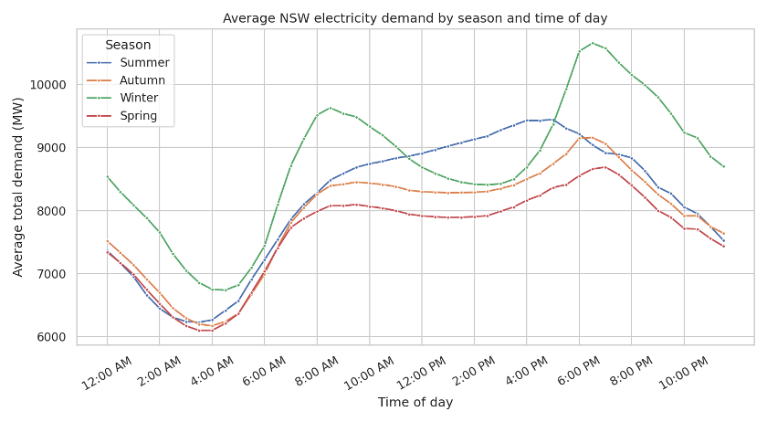
Finding #1: Seasonal Demand Patterns
Winter Has the Highest Average Demand
Highest Usage: Winter
Lowest Usage: Spring
Winter peak
Winter Peak: 58%
Above its daily low
Morning rise
Daytime dip
Summer Peak: 5 pm
Spring Peak: 7 pm
Average electricity use throughout the day in each season .
Key message: demand follows season, time of day and temperature
Source: Group A report, Chapter 4, Figure 4.5, January 2010-March 2021.

Slide 20
Finding #1: Seasonal Demand Patterns
Winter Has the Highest Average Demand
Highest Usage: Winter
Lowest Usage: Spring
Winter peak
Winter Peak: 58%
Above its daily low
Morning rise
Daytime dip
Summer Peak: 5 pm
Spring Peak: 7 pm
Average electricity use throughout the day in each season .
Key message: demand follows season, time of day and temperature
Source: Group A report, Chapter 4, Figure 4.5, January 2010-March 2021.
Notes:
NSW using electricity for the hot water in most buildings

Slide 21
Finding #1: Seasonal Demand Patterns
Winter Has the Highest Average Demand
Highest Usage: Winter
Lowest Usage: Spring
Winter peak
Winter Peak: 58%
Above its daily low
Morning rise
Day time dip
Summer Peak: 5 pm
Spring Peak: 7 pm
Average electricity use throughout the day in each season .
Key message: demand follows season, time of day and temperature
Source: Group A report, Chapter 4, Figure 4.5, January 2010-March 2021.

Slide 22
Finding #1: Seasonal Demand Patterns
Winter Has the Highest Average Demand
Highest Usage: Winter
Lowest Usage: Spring
Winter peak
Winter Peak: 58%
Above its daily low
Morning rise
Daytime dip
Summer Peak: 5 pm
Spring Peak: 7 pm
Average electricity use throughout the day in each season .
Key message: demand follows season, time of day and temperature
Source: Group A report, Chapter 4, Figure 4.5, January 2010-March 2021.

Slide 23
Finding #1: Seasonal Demand Patterns
Winter Has the Highest Average Demand
Highest Usage: Winter
Lowest Usage: Spring
Winter peak
Winter Peak: 58%
Above its daily low
Morning rise
Daytime dip
Summer Peak: 5 pm
Spring Peak: 7 pm
Average electricity use throughout the day in each season .
Key message: demand follows season, time of day and temperature
Source: Group A report, Chapter 4, Figure 4.5, January 2010-March 2021.

Slide 24
Finding #1: Seasonal Demand Patterns
Winter Has the Highest Average Demand
Highest Usage: Winter
Lowest Usage: Spring
Winter peak
Winter Peak: 58%
Above its daily low
Morning rise
Daytime dip
Summer Peak: 5 pm
Spring Peak: 7 pm
Average electricity use throughout the day in each season .
Key message: demand follows season, time of day and temperature
Source: Group A report, Chapter 4, Figure 4.5, January 2010-March 2021.

Slide 25
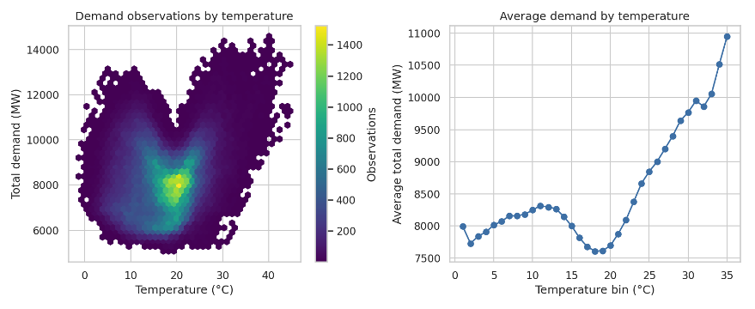
Finding #2: Temperature
Electricity use rises in hot and cold weather.
Lowest Usage:
Mild Weather
Electricity Usage Increase:
Cold Weather
Steeper rise in the heat
Lowest: 18 –20° C
Electricity Usage Increase Faster:
Hot Weather
Each dot shows the average electricity demand at a different temperature.
Electricity use is lowest in mild weather and rises in extreme heat or cold.
Source: Group A report, Chapter 4, Figure 4.11, January 2010-March 2021.

Slide 26
Finding #2: Temperature
Electricity use rises in hot and cold weather.
Lowest Usage:
Mild Weather
Electricity Usage Increase:
Cold Weather
Steeper rise in the heat
Lowest: 18 –20° C
Electricity Usage Increase Faster:
Hot Weather
Each dot shows the average electricity demand at a different temperature.
Electricity use is lowest in mild weather and rises in extreme heat or cold.
Source: Group A report, Chapter 4, Figure 4.11, January 2010-March 2021.

Slide 27
Finding #2: Temperature
Electricity use rises in hot and cold weather.
Lowest Usage:
Mild Weather
Electricity Usage Increase:
Cold Weather
Steeper rise in the heat
Lowest: 18 –20° C
Electricity Usage Increase Faster:
Hot Weather
Each dot shows the average electricity demand at a different temperature.
Electricity use is lowest in mild weather and rises in extreme heat or cold.
Source: Group A report, Chapter 4, Figure 4.11, January 2010-March 2021.

Slide 28
Finding #2: Temperature
Electricity use rises in hot and cold weather.
Lowest Usage:
Mild Weather
Electricity Usage Increase:
Cold Weather
Steeper rise in the heat
Lowest: 18 –20° C
Electricity Usage Increase Faster:
Hot Weather
Each dot shows the average electricity demand at a different temperature.
Electricity use is lowest in mild weather and rises in extreme heat or cold.
Source: Group A report, Chapter 4, Figure 4.11, January 2010-March 2021.

Slide 29
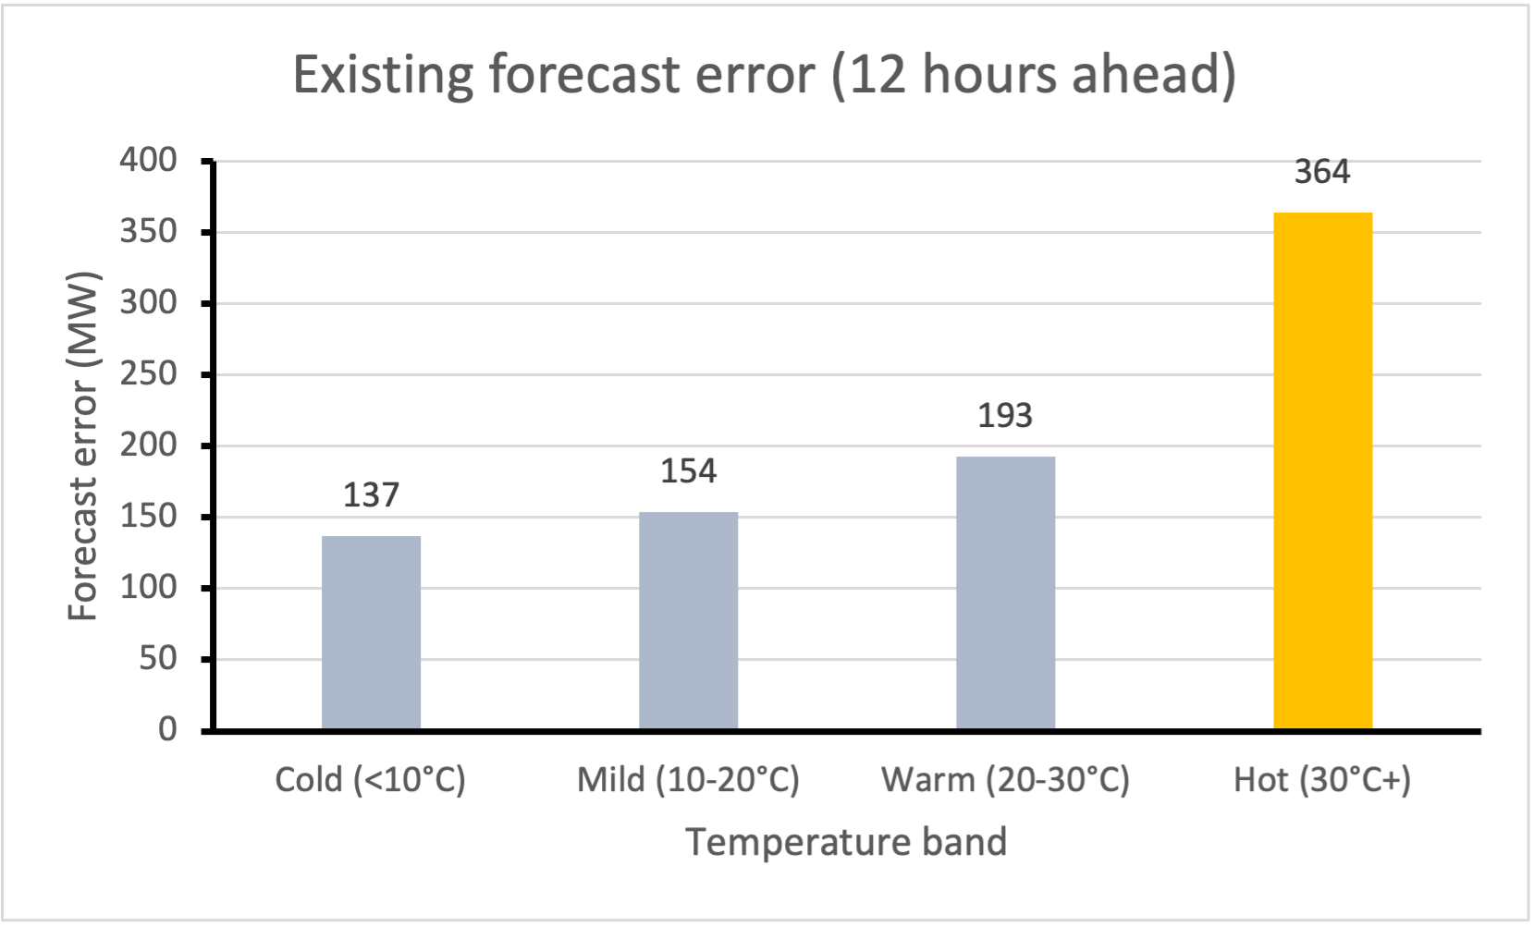
Finding # 3 Hot days: Hardest to Forecast
AEMO forecasts: error more than doubles in the heat
Cold: 137 MW
Average Error
Hot: 364 MW
Average Error
Hot Conditions
Forecast errors increase sharply in extreme heat
Bar: average error of the existing forecast
Demand follow the weather and the time of day; heat is hardest to forecast.
Source: Group A report, Chapter 4, Table 4.2; AEMO 12-hour forecast , Jan 2010 –Mar 2021

Slide 30
Finding # 3 Hot days are Hardest to Forecast
Existing AEMO forecasts: error more than doubles in the heat
Cold: 137 MW
Average Error
Hot: 364 MW
Average Error
Hot Conditions
Forecast errors increase sharply in extreme heat
Bar: average error of the existing forecast
Demand follow the weather and the time of day; heat is hardest to forecast.
Source: Group A report, Chapter 4, Table 4.2; AEMO 12-hour forecast , Jan 2010 –Mar 2021

Slide 31
Finding # 3 Hot days are Hardest to Forecast
Existing AEMO forecasts: error more than doubles in the heat
Cold: 137 MW
Average Error
Hot: 364 MW
Average Error
Hot Conditions
Forecast errors increase sharply in extreme heat
Bar: average error of the existing forecast
Demand follow the weather and the time of day; heat is hardest to forecast.
Source: Group A report, Chapter 4, Table 4.2; AEMO 12-hour forecast , Jan 2010 –Mar 2021

Slide 32
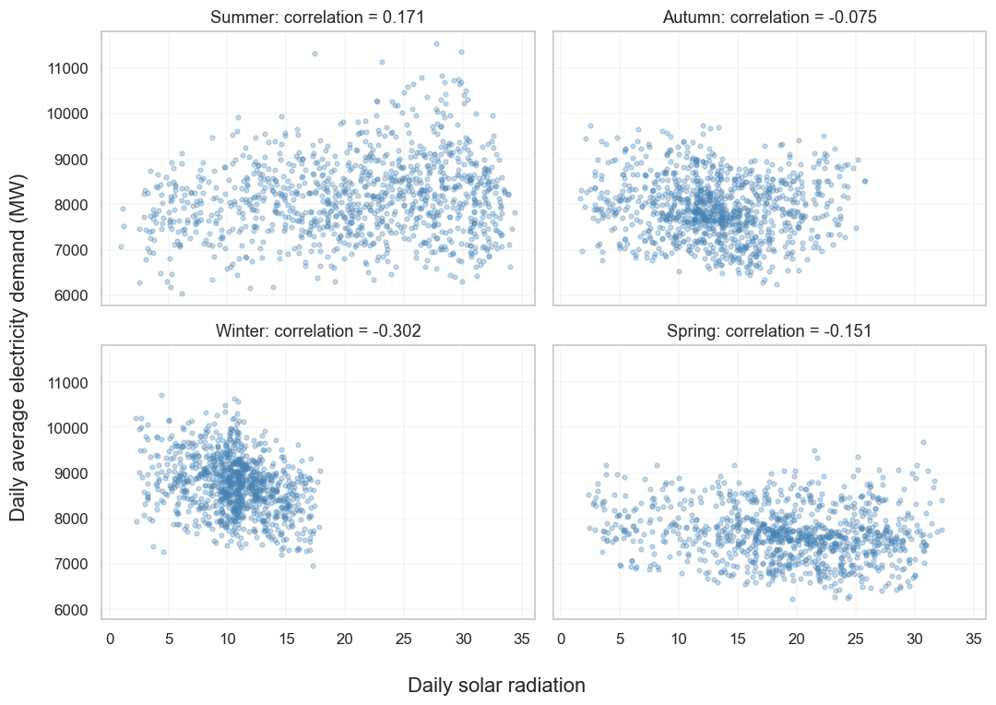
Finding #4: Solar Radiation
Seasonal Solar Radiation Dynamics
Overall Relationship:
Weak Negative
Association (r = -0.176)
Seasonal Differences:
Negative in Winter
(-0.302)
Weakly Positive in Summer
( +0.171)
Forecasting Value:
Need Testing with + without Radiation
Source: Group A report, Chapter 4, Figure 4.12a Daily radiation analysis, 4,094 complete days.

Slide 33
5. Results
by Xavier
Notes:
Hi everyone, my name is Xavier, the data scientist and product manager in our group.
I will walk you through what happened when we put all six models to the test.

Slide 34
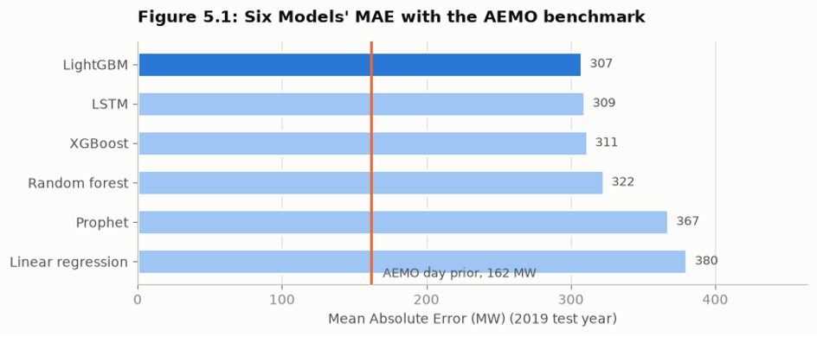
Result: Best Performing Model
LightGBM
Average Error by Model in 2019 (MW)
LightGBM: 3.74%
Average Error about 307 MW
vs. Baseline: +19% ⤴
More accurate
Gap in Top 3: 4 MW
A nearly tie on top 3 models
Source: Chapter 5, Figure 5.1, Six Models’ MAE with the AEMO benchmark.
Notes:
First, the headline. Across the whole 2019 test year, LightGBM made the most accurate forecasts.
On average it was off by about 307 megawatts per half hour, which is roughly 3.74% of the demand.

Slide 35
Result: Best Performing Model
LightGBM
Average Error by Model in 2019 (MW)
LightGBM: 3.74%
Average Error about 307 MW
vs. Baseline: +19% ⤴
More accurate
Gap in Top 3: 4 MW
A nearly tie on top 3 models
Source: Chapter 5, Figure 5.1, Six Models’ MAE with the AEMO benchmark.
Notes:
That’s 19% more accurate than our simple baseline model.

Slide 36
Result: Best Performing Model
LightGBM
Average Error by Model in 2019 (MW)
LightGBM: 3.74%
Average Error about 307 MW
vs. Baseline: +19% ⤴
More accurate
Gap in Top 3: 4 MW
A nearly tie on top 3 models
Source: Chapter 5, Figure 5.1, Six Models’ MAE with the AEMO benchmark.
Notes:
However, looking at the top of the chart, LightGBM, LSTM and XGBoost are separated by just 4 megawatts.
That’s a near tie, so average accuracy alone can’t tell us which model to trust.

Slide 37
Result: Best Performing Model
LightGBM
Average Error by Model in 2019 (MW)
LightGBM: 3.74%
Average Error about 307 MW
vs. Baseline: +19% ⤴
More accurate
Gap in Top 3: 4 MW
A nearly tie on top 3 models
Source: Chapter 5, Figure 5.1, Six Models’ MAE with the AEMO benchmark.
Notes:
The orange line is AEMO’s own forecast, at about half our error. It has something our model do not have, which is the tomorrow’s weather forecast and others.

Slide 38
Which model holds up when conditions change?
QUESTION
Notes:
So we asked a second question: which model holds up when conditions change?

Slide 39
LightGBM: Most Consistent
Operational Conditions
Model Name | Summer | Autumn | Winter | Spring | 18 ºC + | Below 18 ºC | School Term | School Holiday | Times first | Worst rank
LightGBM | 1 | 1 | 1 | 2 | 1 | 2 | 2 | 1 | 5 | 2
LSTM | 2 | 4 | 4 | 1 | 2 | 3 | 1 | 4 | 2 | 4
XGBoost | 3 | 2 | 2 | 3 | 3 | 1 | 3 | 2 | 1 | 3
Random Forest | 4 | 3 | 3 | 4 | 4 | 4 | 4 | 3 | 0 | 4
Prophet | 5 | 5 | 5 | 5 | 5 | 5 | 5 | 6 | 0 | 6
Baseline Linear Regression | 6 | 6 | 6 | 6 | 6 | 6 | 6 | 5 | 0 | 6
Most Consistent
Ranked 1st : Gained 5 out of 8 operational conditions
Worse Rank: Never worse than 2nd place
Source: Chapter 5, Table A.7, Model Rank Within Each Segment.
Notes:
We split the year into eight conditions:
the four seasons,
warmer and cooler days, and
school terms vs. holidays.
Then we ranked all six models in each one.
LightGBM came first in five of the eight, and it was never worse than second.
LSTM matched it on average, but swung from first place to fourth depending on the conditions.

Slide 40
LightGBM: Most Consistent
Operational Conditions
Model Name | Summer | Autumn | Winter | Spring | 18 ºC + | Below 18 ºC | School Term | School Holiday | Times first | Worst rank
LightGBM | 1 | 1 | 1 | 2 | 1 | 2 | 2 | 1 | 5 | 2
LSTM | 2 | 4 | 4 | 1 | 2 | 3 | 1 | 4 | 2 | 4
XGBoost | 3 | 2 | 2 | 3 | 3 | 1 | 3 | 2 | 1 | 3
Random Forest | 4 | 3 | 3 | 4 | 4 | 4 | 4 | 3 | 0 | 4
Prophet | 5 | 5 | 5 | 5 | 5 | 5 | 5 | 6 | 0 | 6
Baseline Linear Regression | 6 | 6 | 6 | 6 | 6 | 6 | 6 | 5 | 0 | 6
Most Consistent
Ranked 1st : Gained 5 out of 8 operational conditions
Worse Rank: Never worse than 2nd place
Source: Chapter 5, Table A.7, Model Rank Within Each Segment.
Notes:
For a business that needs a forecast it can rely on every day, that consistency maters more than a tiny lead on average.
That’s why LightGBM is our pick.

Slide 41
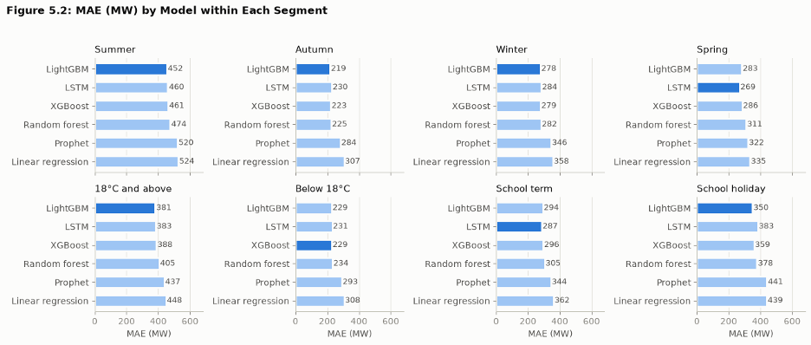
Every Model Struggles in Summer
The Highest Average Error Across All Models
Average Error by Operational Conditions in 2019 (MW)
MAE Summer: Doubled
Average error vs. Autumn
MAE Summer: > 60%
Average error vs. Winter
& vs. Spring
Most Stable: Autumn
Lowest error in all models and operational conditions
Average error (MAE) in Summer is doubled vs. Automn, and over 60% jump vs. Winter & Spring.
Summer becomes the most challenging season to predict an accurate power demand.
Automn in becomes the most stable season to predict a more accurate power demand across all models + operational conditions.
Source: Chapter 5, Figure 5.2, MAE (MW) by Model within Each Segment.
Notes:
But even the best model has a weak spot, and it’s the same for every single model: SUMMER!!!
Summer errors are roughly doubled autumn’s,

Slide 42
Every Model Struggles in Summer
The Highest Average Error Across All Models
Average Error by Operational Conditions in 2019 (MW)
MAE Summer: Doubled
Average error vs. Autumn
MAE Summer: > 60%
Average error vs. Winter
& vs. Spring
Most Stable: Autumn
Lowest error in all models and operational conditions
Average error (MAE) in Summer is doubled vs. Automn, and over 60% jump vs. Winter & Spring.
Summer becomes the most challenging season to predict an accurate power demand.
Automn in becomes the most stable season to predict a more accurate power demand across all models + operational conditions.
Source: Chapter 5, Figure 5.2, MAE (MW) by Model within Each Segment.
Notes:
and about 60% higher than winter or spring.

Slide 43
Every Model Struggles in Summer
The Highest Average Error Across All Models
Average Error by Operational Conditions in 2019 (MW)
MAE Summer: Doubled
Average error vs. Autumn
MAE Summer: > 60%
Average error vs. Winter
& vs. Spring
Most Stable: Autumn
Lowest error in all models and operational conditions
Average error (MAE) in Summer is doubled vs. Automn, and over 60% jump vs. Winter & Spring.
Summer becomes the most challenging season to predict an accurate power demand.
Automn in becomes the most stable season to predict a more accurate power demand across all models + operational conditions.
Source: Chapter 5, Figure 5.2, MAE (MW) by Model within Each Segment.
Notes:
Autumn is the easiest season for all six models.

Slide 44
Every Model Struggles in Summer
The Highest Average Error Across All Models
Average Error by Operational Conditions in 2019 (MW)
MAE Summer: Doubled
Average error vs. Autumn
MAE Summer: > 60%
Average error vs. Winter
& vs. Spring
Most Stable: Autumn
Lowest error in all models and operational conditions
Average error (MAE) in Summer is doubled vs. Automn, and over 60% jump vs. Winter & Spring.
Summer becomes the most challenging season to predict an accurate power demand.
Automn in becomes the most stable season to predict a more accurate power demand across all models + operational conditions.
Source: Chapter 5, Figure 5.2, MAE (MW) by Model within Each Segment.
Source: https://www.aemo.com.au/energy-systems/electricity/national-electricity-market-nem/nem-forecasting-and-planning/operational-forecasting/load-forecasting-in-pre-dispatch-and-stpasa
Notes:
Why?
Because summer brings heatwaves and sudden cool changes.
Our models only know yesterday’s weather, so when tomorrow is very different from today, they miss.
AEMO’s forecast also draws on tomorrow’s weather forecast and other data that we didn’t have.
And that leads into our recommendations. Over to Arman.

Slide 45
6. Proposal
by Arman

Slide 46
NSW’s changing electricity demand
1
Growing demand
~12%
Communities, industry and electrification
NSW demand: Tomago Aluminium [1]
2
Changing grid use
~1 in 4
Rooftop solar and energy efficiency
NSW households have rooftop solar [2]
3
Changing timing
100,000+
Home batteries and EV charging
Registered EVs in NSW by Nov 2025 [3]
[1] Rio Tinto: Tomago (n.d.)
[2] NSW Government: energy system (n.d.)
[3] NSW Government: EV milestone (29 Nov 2025)
Notes:
OPENING
Looking beyond our results, how can forecasting keep up with a changing NSW?
POINT 1: Growing demand
First, growing communities and businesses switching to electricity can increase demand. Large industries and new data centres matter too. Tomago Aluminium alone accounts for around twelve per cent of NSW’s demand. So forecasting needs to follow changes across households and major businesses.
POINT 2: Changing grid use
Second, how much electricity people draw from the grid is changing. The NSW Government reports that around one in four households has rooftop solar, so a sunny afternoon can reduce their need for grid electricity. More efficient buildings and appliances can also reduce consumption.
POINT 3: Changing timing
Third, the timing is changing. NSW passed one hundred thousand registered electric vehicles by late 2025. Charging after work creates a different demand pattern from charging overnight or during the day. Home batteries can also store daytime solar for evening use.
TRANSITION
Together, these changes lead to three recommendations.
REFERENCES
[1] Rio Tinto, Tomago, n.d. https://www.riotinto.com/en/operations/anz/tomago
[2] NSW Government, How our energy system is changing, n.d. https://www.energy.nsw.gov.au/households/action/energy-changing
[3] NSW Government, NSW EV Milestone, 29 November 2025. https://www.nsw.gov.au/ministerial-releases/nsw-ev-milestone-over-100000-electric-vehicles-registered-121-million-litres-of-petrol-saved
Additional context: NSW EPA, Energy consumption 2024. https://www.soe.epa.nsw.gov.au/all-themes/people-and-industry/energy-consumption-2024
Figures describe different reporting dates. The solar estimate is the NSW Government overview, rather than a new 2026 census. Viewed 10 October 2026.

Slide 47
NSW’s changing electricity demand
1
Growing demand
~12%
Communities, industry and electrification
NSW demand: Tomago Aluminium [1]
2
Changing grid use
~1 in 4
Rooftop solar and energy efficiency
NSW households have rooftop solar [2]
3
Changing timing
100,000+
Home batteries and EV charging
Registered EVs in NSW by Nov 2025 [3]
[1] Rio Tinto: Tomago (n.d.)
[2] NSW Government: energy system (n.d.)
[3] NSW Government: EV milestone (29 Nov 2025)
Notes:
OPENING
Looking beyond our results, how can forecasting keep up with a changing NSW?
POINT 1: Growing demand
First, growing communities and businesses switching to electricity can increase demand. Large industries and new data centres matter too. Tomago Aluminium alone accounts for around twelve per cent of NSW’s demand. So forecasting needs to follow changes across households and major businesses.
POINT 2: Changing grid use
Second, how much electricity people draw from the grid is changing. The NSW Government reports that around one in four households has rooftop solar, so a sunny afternoon can reduce their need for grid electricity. More efficient buildings and appliances can also reduce consumption.
POINT 3: Changing timing
Third, the timing is changing. NSW passed one hundred thousand registered electric vehicles by late 2025. Charging after work creates a different demand pattern from charging overnight or during the day. Home batteries can also store daytime solar for evening use.
TRANSITION
Together, these changes lead to three recommendations.
REFERENCES
[1] Rio Tinto, Tomago, n.d. https://www.riotinto.com/en/operations/anz/tomago
[2] NSW Government, How our energy system is changing, n.d. https://www.energy.nsw.gov.au/households/action/energy-changing
[3] NSW Government, NSW EV Milestone, 29 November 2025. https://www.nsw.gov.au/ministerial-releases/nsw-ev-milestone-over-100000-electric-vehicles-registered-121-million-litres-of-petrol-saved
Additional context: NSW EPA, Energy consumption 2024. https://www.soe.epa.nsw.gov.au/all-themes/people-and-industry/energy-consumption-2024
Figures describe different reporting dates. The solar estimate is the NSW Government overview, rather than a new 2026 census. Viewed 10 October 2026.

Slide 48
NSW’s changing electricity demand
1
Growing demand
~12%
Communities, industry and electrification
NSW demand: Tomago Aluminium [1]
2
Changing grid use
~1 in 4
Rooftop solar and energy efficiency
NSW households have rooftop solar [2]
3
Changing timing
100,000+
Home batteries and EV charging
Registered EVs in NSW by Nov 2025 [3]
[1] Rio Tinto: Tomago (n.d.)
[2] NSW Government: energy system (n.d.)
[3] NSW Government: EV milestone (29 Nov 2025)
Notes:
OPENING
Looking beyond our results, how can forecasting keep up with a changing NSW?
POINT 1: Growing demand
First, growing communities and businesses switching to electricity can increase demand. Large industries and new data centres matter too. Tomago Aluminium alone accounts for around twelve per cent of NSW’s demand. So forecasting needs to follow changes across households and major businesses.
POINT 2: Changing grid use
Second, how much electricity people draw from the grid is changing. The NSW Government reports that around one in four households has rooftop solar, so a sunny afternoon can reduce their need for grid electricity. More efficient buildings and appliances can also reduce consumption.
POINT 3: Changing timing
Third, the timing is changing. NSW passed one hundred thousand registered electric vehicles by late 2025. Charging after work creates a different demand pattern from charging overnight or during the day. Home batteries can also store daytime solar for evening use.
TRANSITION
Together, these changes lead to three recommendations.
REFERENCES
[1] Rio Tinto, Tomago, n.d. https://www.riotinto.com/en/operations/anz/tomago
[2] NSW Government, How our energy system is changing, n.d. https://www.energy.nsw.gov.au/households/action/energy-changing
[3] NSW Government, NSW EV Milestone, 29 November 2025. https://www.nsw.gov.au/ministerial-releases/nsw-ev-milestone-over-100000-electric-vehicles-registered-121-million-litres-of-petrol-saved
Additional context: NSW EPA, Energy consumption 2024. https://www.soe.epa.nsw.gov.au/all-themes/people-and-industry/energy-consumption-2024
Figures describe different reporting dates. The solar estimate is the NSW Government overview, rather than a new 2026 census. Viewed 10 October 2026.

Slide 49
Future forecasting in NSW
1
Look ahead
Better weather forecasts across NSW
2
Keep up
Track major users and technology adoption
3
Stay reliable
Refresh models and test changing conditions
Sources: AEMO, operational load forecasting (n.d.)
NSW EPA, Energy consumption 2024
Notes:
POINT 1: Look ahead
First, look ahead with better weather information. Forecasts of temperature, humidity and sunshine across several NSW locations could help anticipate tomorrow’s conditions, especially when they’re different from yesterday.
POINT 2: Keep up
Second, keep up with changes in electricity use. That includes major industrial developments, rooftop solar, EV charging and batteries. For solar, knowing how sunny it will be is only part of the picture. We also need to know how much solar capacity is installed.
POINT 3: Stay reliable
Third, keep checking reliability. Our study tested performance on 2019 data. More recent years would help show whether those results still hold. We should also check extreme weather and peak demand, because a good average result can hide larger errors.
CLOSING
Our project gives us a useful starting point. The next step is to combine a suitable model with information that reflects NSW today, and keep checking it as electricity use changes. Thank you.
REFERENCES
AEMO, Load forecasting in pre-dispatch and STPASA, n.d. https://www.aemo.com.au/energy-systems/electricity/national-electricity-market-nem/nem-forecasting-and-planning/operational-forecasting/load-forecasting-in-pre-dispatch-and-stpasa
NSW EPA, Energy consumption 2024. https://www.soe.epa.nsw.gov.au/all-themes/people-and-industry/energy-consumption-2024
Group A project report and shared model datasets: training 2010–2017, validation 2018, testing 2019.
These are recommendations for future testing, rather than improvements established by the project. Viewed 10 October 2026.

Slide 50
Future forecasting in NSW
1
Look ahead
Better weather forecasts across NSW
2
Keep up
Track major users and technology adoption
3
Stay reliable
Refresh models and test changing conditions
Sources: AEMO, operational load forecasting (n.d.)
NSW EPA, Energy consumption 2024
Notes:
POINT 1: Look ahead
First, look ahead with better weather information. Forecasts of temperature, humidity and sunshine across several NSW locations could help anticipate tomorrow’s conditions, especially when they’re different from yesterday.
POINT 2: Keep up
Second, keep up with changes in electricity use. That includes major industrial developments, rooftop solar, EV charging and batteries. For solar, knowing how sunny it will be is only part of the picture. We also need to know how much solar capacity is installed.
POINT 3: Stay reliable
Third, keep checking reliability. Our study tested performance on 2019 data. More recent years would help show whether those results still hold. We should also check extreme weather and peak demand, because a good average result can hide larger errors.
CLOSING
Our project gives us a useful starting point. The next step is to combine a suitable model with information that reflects NSW today, and keep checking it as electricity use changes. Thank you.
REFERENCES
AEMO, Load forecasting in pre-dispatch and STPASA, n.d. https://www.aemo.com.au/energy-systems/electricity/national-electricity-market-nem/nem-forecasting-and-planning/operational-forecasting/load-forecasting-in-pre-dispatch-and-stpasa
NSW EPA, Energy consumption 2024. https://www.soe.epa.nsw.gov.au/all-themes/people-and-industry/energy-consumption-2024
Group A project report and shared model datasets: training 2010–2017, validation 2018, testing 2019.
These are recommendations for future testing, rather than improvements established by the project. Viewed 10 October 2026.

Slide 51
Future forecasting in NSW
1
Look ahead
Better weather forecasts across NSW
2
Keep up
Track major users and technology adoption
3
Stay reliable
Refresh models and test changing conditions
Sources: AEMO, operational load forecasting (n.d.)
NSW EPA, Energy consumption 2024
Notes:
POINT 1: Look ahead
First, look ahead with better weather information. Forecasts of temperature, humidity and sunshine across several NSW locations could help anticipate tomorrow’s conditions, especially when they’re different from yesterday.
POINT 2: Keep up
Second, keep up with changes in electricity use. That includes major industrial developments, rooftop solar, EV charging and batteries. For solar, knowing how sunny it will be is only part of the picture. We also need to know how much solar capacity is installed.
POINT 3: Stay reliable
Third, keep checking reliability. Our study tested performance on 2019 data. More recent years would help show whether those results still hold. We should also check extreme weather and peak demand, because a good average result can hide larger errors.
CLOSING
Our project gives us a useful starting point. The next step is to combine a suitable model with information that reflects NSW today, and keep checking it as electricity use changes. Thank you.
REFERENCES
AEMO, Load forecasting in pre-dispatch and STPASA, n.d. https://www.aemo.com.au/energy-systems/electricity/national-electricity-market-nem/nem-forecasting-and-planning/operational-forecasting/load-forecasting-in-pre-dispatch-and-stpasa
NSW EPA, Energy consumption 2024. https://www.soe.epa.nsw.gov.au/all-themes/people-and-industry/energy-consumption-2024
Group A project report and shared model datasets: training 2010–2017, validation 2018, testing 2019.
These are recommendations for future testing, rather than improvements established by the project. Viewed 10 October 2026.

Slide 52
Thank You
Group A

